Slide 1
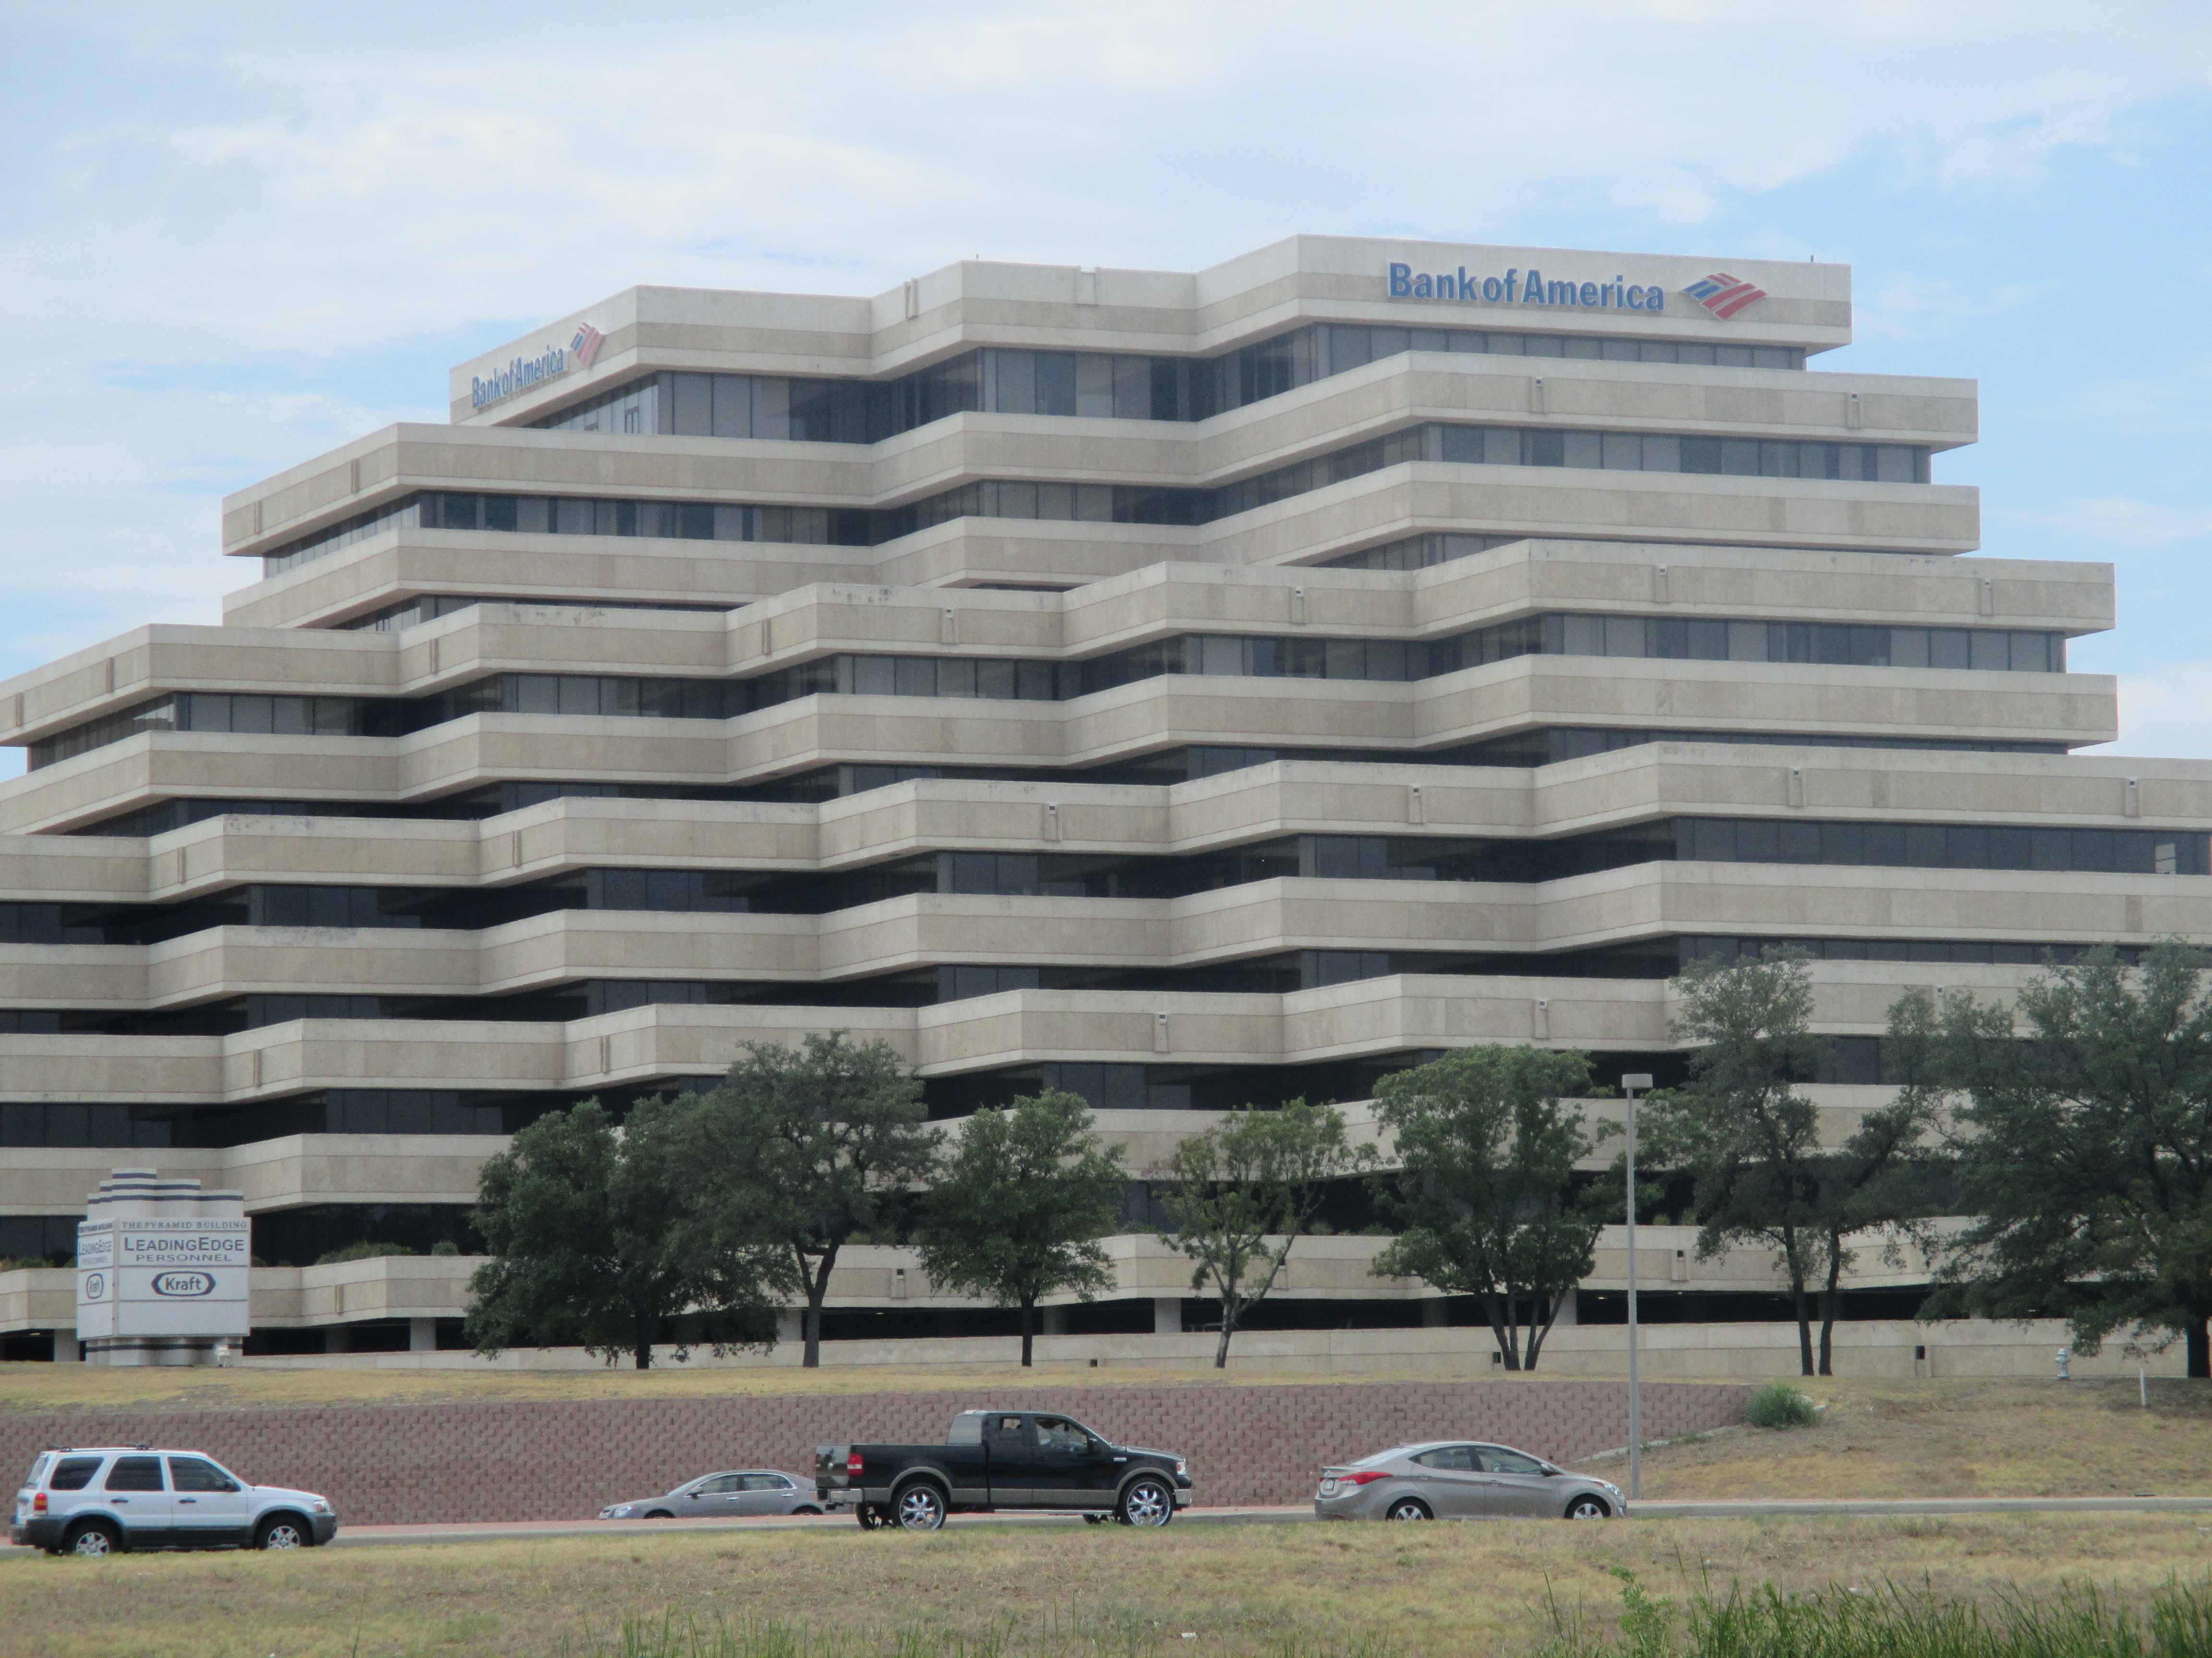
Loan Default Prediction
By Sharel Cooper
Employing Data Analysis,
Machine Learning & Neural Networks

Slide 2


01
Motivation
02
03
Analysis
Machine Learning
04
Conclusions

Slide 3
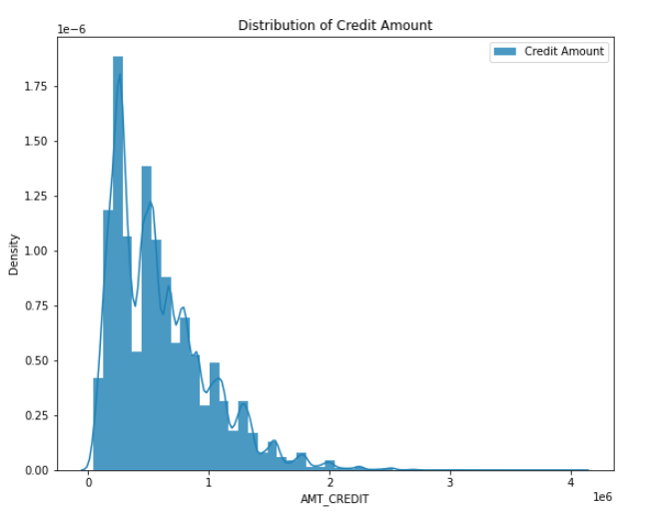
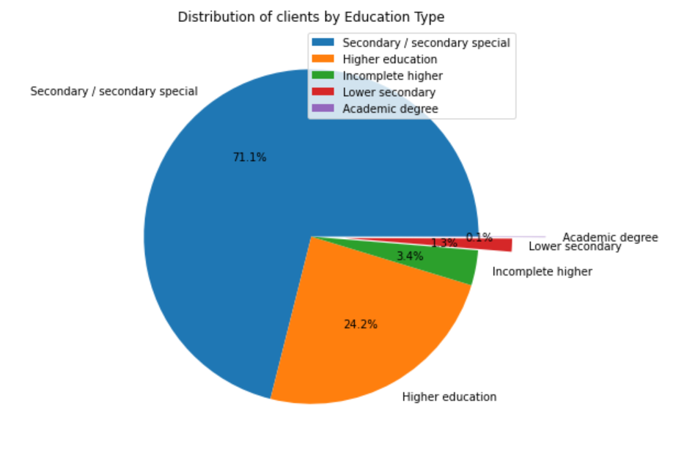
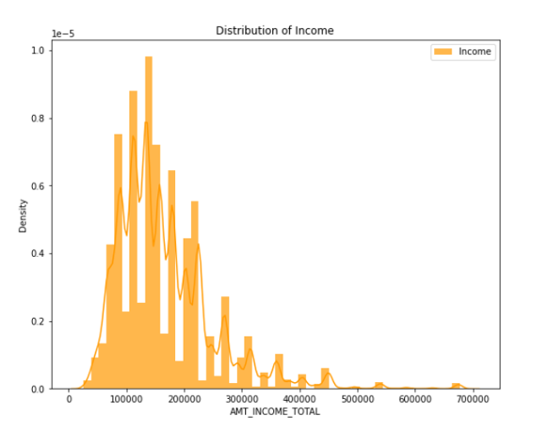
Motivation
Loan defaults are a significant risk to the revenue and solvency of the entire banking sector.
ANALYZE
MODEL
BOTTOM-LINE
Explore and analyze what factors influence clients’ default
Build a Machine Learning Model to predict client default
Efficient risk management through ML & application processes streamlineing

Slide 4
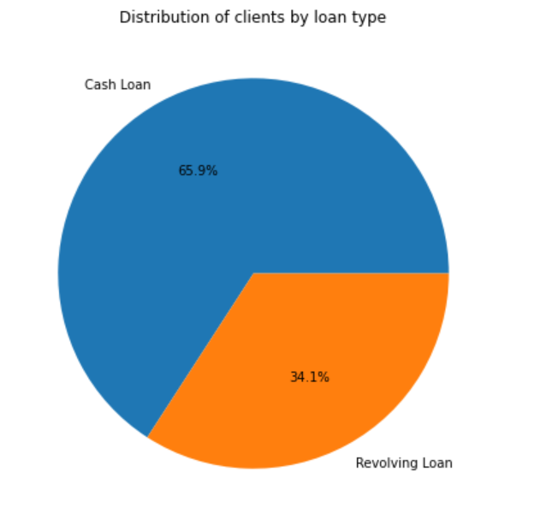
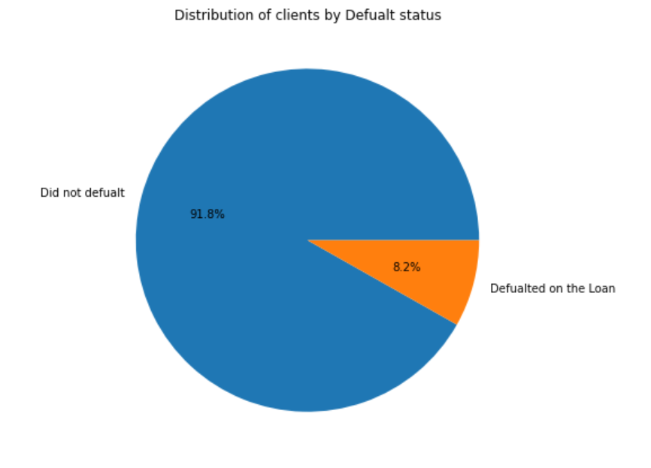
Dataset Contents
RECORDS
FEATURES
370,000 unique lenders & whether they defaulted on the loan or not
120+ features including income, asset ownership, employment & more
VALUES
COMPLEXITY
Unbalanced data. Null values. Skewness.
Dataset is very complex. My results are better than most others who have tried this dataset.

Slide 5
Analysis
Features used: Bar charts, scatter plots, histograms, box plots, pie charts, etc.
Ethical considerations must be made before using any of the following insights:
EMPLOYMENT PERIOD
INCOME OF CLIENT
Clients with a shorter employment period are more likely to default on the loan
Lower income on average results in increased probability for loan default
AGE OF CLIENT
Younger clients are more likely to default on the loan
OCCUPATION TYPE
Laborers are over represented in the Loan Default category.

Slide 6
Analysis
Features used: Bar charts, scatter plots, histograms, box plots, pie charts, etc.
Ethical considerations must be made before using any of the following insights:
HOUSING TYPE
EDUCATION LEVEL
Renters are overrepresented in the Loan Default category.
Higher-educated people defaulted less on their loan vs. highschoolers
FAMILY STATUS & GENDER
Males & married couples are overrepresented in the Loan Default category
ASSET OWNERSHIP
Those with assets are less likely to default on the loan.

Slide 7
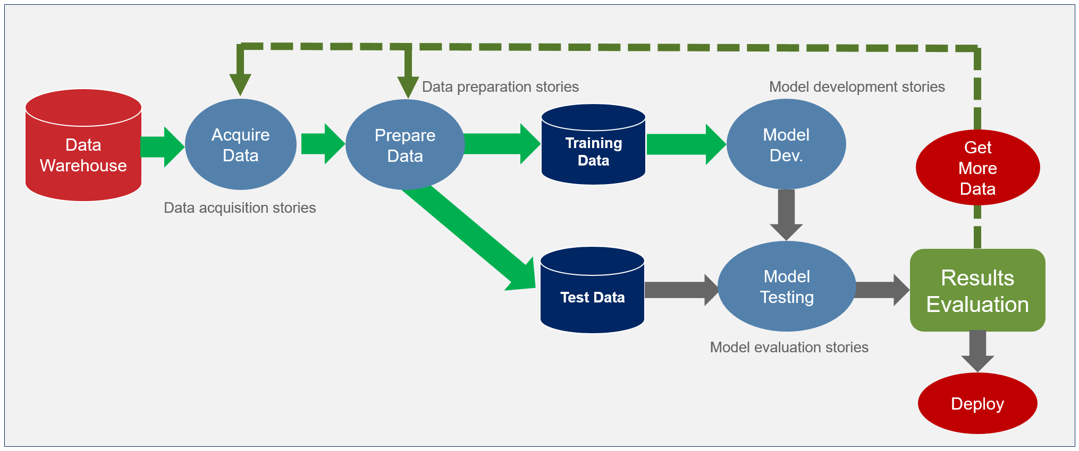




Pipeline: Model Overview
SQL | Data Cleaning | Feature Engineering | EDA | ML Modelling | Deployment

Slide 8
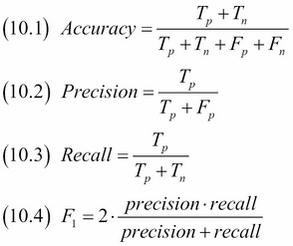
Motivation
Machine Learning Results
Supervised Learning Algorithms:
Classifier | Accuracy | CV Accuracy | Precision | Recall | F1 Score
Decision Tree | 0.822958 | 0.842426 | 0.109595 | 0.163043 | 0.13108
RandomForest | 0.913562 | 0.918148 | 0.203947 | 0.019073 | 0.034884
Naive Bayes | 0.233766 | 0.087966 | 0.089014 | 0.90484 | 0.162084
KNeighbours | 0.670071 | 0.912285 | 0.100011 | 0.378589 | 0.158224
Logistic Regression | 0.626382 | 0.918097 | 0.128323 | 0.614848 | 0.21233
AdaBoostClassifier | 0.816827 | 0.918097 | 0.1416 | 0.244258 | 0.179273
Gradient Boosting Classifier | 0.915326 | 0.917996 | 0.225914 | 0.013946 | 0.02627
XGBoost | 0.917509 | 0.916989 | 0.330097 | 0.006973 | 0.013657
Recall is the most important metric for our purposes.
Model could be tuned for other metrics based on desired risk profile.
Deep Learning Neural Network:
Classifier | Accuracy | Recall | Precision | F1 Score
ANN | 0.8334 | 0.2235 | 0.1509 | 0.1801

Slide 9
Conclusions & Future
ANALYSIS ACTIONS:
We can focus on the highlights of our analysis when evaluating new loan applications to cut time spent on less significant factors.
ML ACTIONS:
Our ML model can see what clients have a higher probability of defaulting, cutting down manual employee time.
FUTURE:
Optimize our risk management strategies & make the loan application processes more efficient and streamlined, cutting processing costs.

Slide 10
THANK YOU!
DOES ANYONE HAVE ANY QUESTIONS?
Sharel.cooper@outlook.com
You can find the code and work presented on my GitHub: https://github.com/SharelCooper

